Slide 1



Cardiovascular Disease Prediction Model
Notes:
(Note: these notes are to share methodology and were not used for memorization or read during presentation, they are for tying story with a thread and baseline for practice sessions)
Hi ____ ! thank you for joining me today! =^_^=
The focus of this presentation will be a Cardiovascular disease prediction model.
We will go over why this is an important problem, the approach used to find a solution and test how reliable our solution is.

Slide 2
Problem Statement
Cost Effective Early Identification of Potential Cardiovascular Events using
Demographic factors
Medical history
Notes:
Cardio issues are often caught late, after the onset of symptoms.
It is strange doing a presentation on this topic during the same month when a chess player died of heart attack in middle of a game.
Heart condition and issues usually come to surface after first minor or major incident, till then it is easy to consider health as our norm.
Our goal is to come up with a cost-effective way of catching heart issues early on, with the amount of information available on our fingertips via smart phones and watches. We are capable of being aware of our heart health and its trajectory much early on.

Slide 3
Target Label
5 Heart Conditions Combined
Binary Classification Problem
11% Positive Cases Imbalanced Dataset - Oversampling

Slide 4
Methodology
Data Collection
Data Cleaning
Exploring Data Analysis
Preprocessing
Modeling
Notes:
We have followed a standard data science methodology from collecting and cleaning data to exploring it and building predictive models.
While ideally these steps go sequentially in reality one is rarely done with data cleaning in one go. Often the most revisited step in the Data science process.

Slide 5

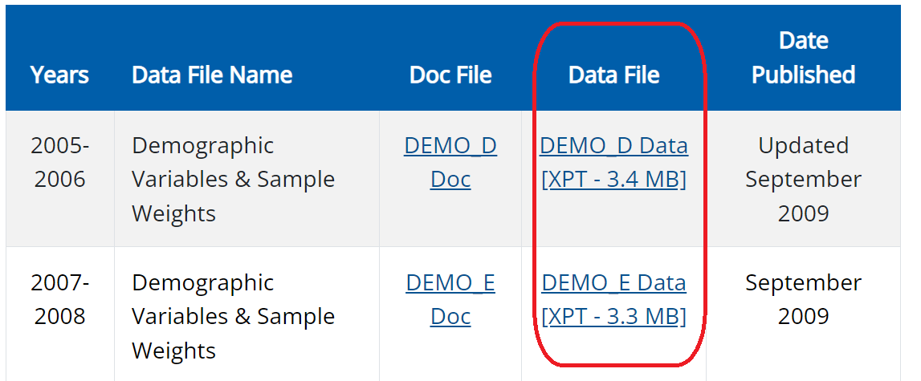
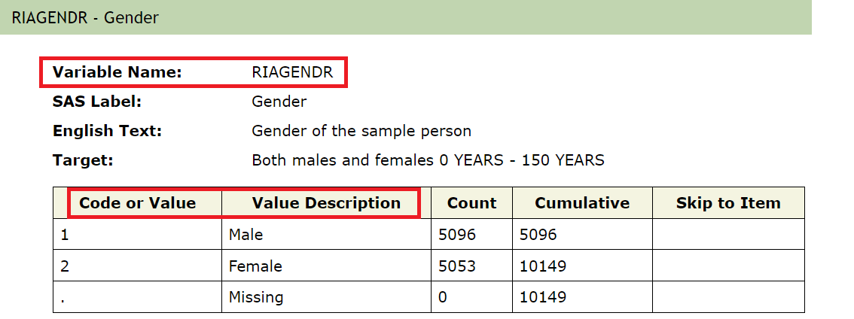
Data Collection
2005 – 2016
60 CDC Files
60,000 rows and 29 columns
Hardcoded Variables
Notes:
Our data comes from CDC website, spanning over 10 years and with more than 60,000 participants.
The data was combined into one big table, with each participant having their own unique identifier as well as several demographic and medical data.
Here for example, we can see the gender coded 1 for male and 2 for female.
All the columns had their own unique name as well hard coded values that needed cleaning.

Slide 6
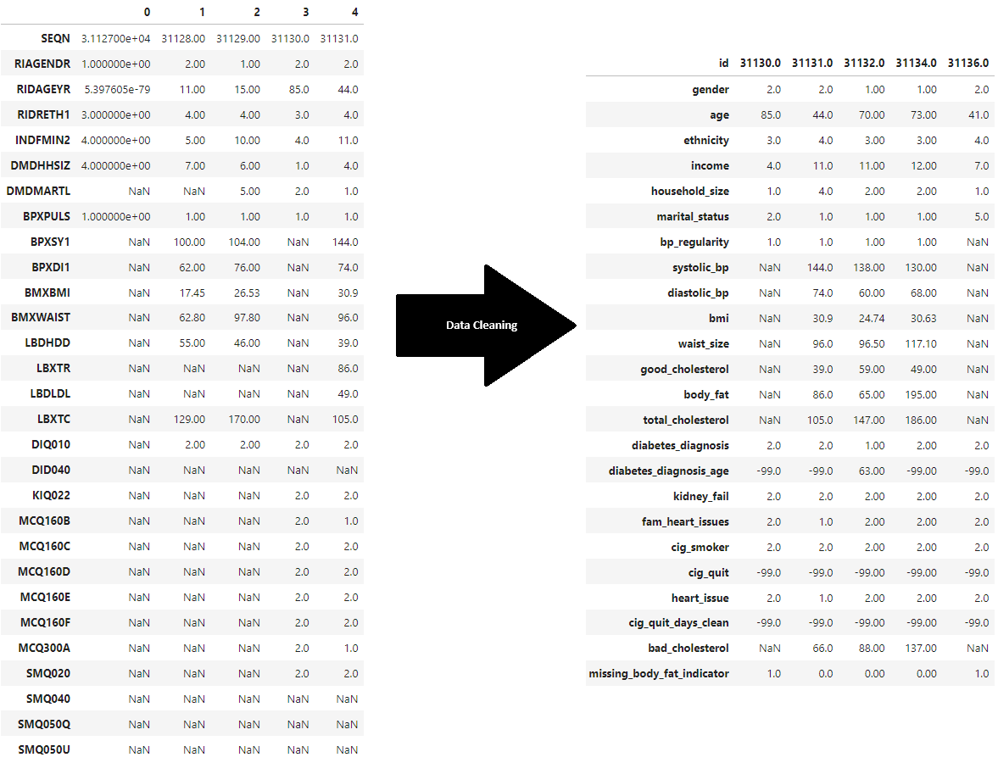
Data Cleaning
Column Names
Hardcoded Names and Values
29 Features
Notes:
Here on the right, we can see our raw data taking a more meaning full shape, with clear column names and values that make sense.
During this stage we dropped participants 20 years or younger as most of them had missing information regarding our target label heart issues.
We also combined the 5 different heart conditions such as heart attack, heart stroke or angina. While we still have missing values for other columns, all our entries have the value for our target label present.
At this stage we have information for around 35,000 participants to move forward

Slide 7
Data Cleaning
Dropping Entries – Younger than 20
Dealing with number of days since last cigarette
Missing Body Fat Indicator

Slide 8
Exploratory Data Analysis
Statistical Summary
.describe() – average age 50
Numerical Features
Categorical Features
Correlations

Slide 9
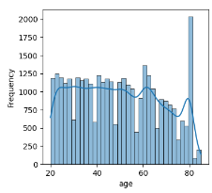
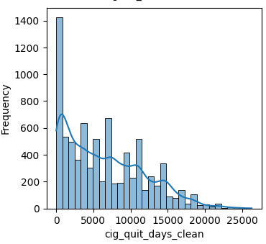
Numerical Features
Boxplots
Histplots

Slide 10
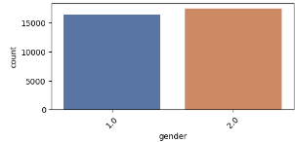
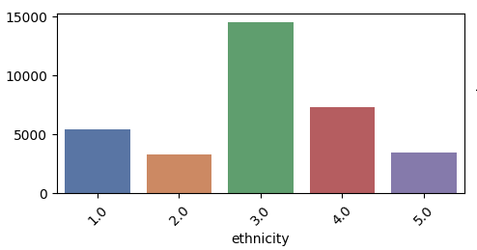
Binary or Categorical Features
Countplots
Balanced Gender Distribution
Most Common Ethnicity
– Non-Hispanic White
Notes:
Here I wanted to share a couple of other insights that jumped out for our dataset.
We see that majority of our participants are from same ethnicity, “Non-hispanic White”
We also see that when it comes to participants who quite smoking, as the number of years since last smoke increases the number of participant decreases.
Similarly, we looked at all numerical and (non-numerical)categorical columns

Slide 11
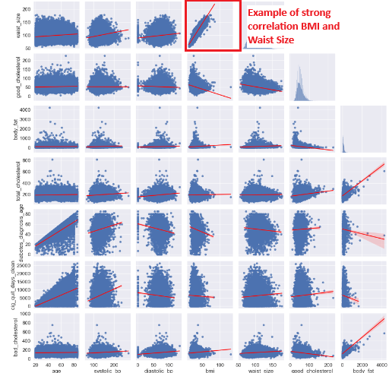
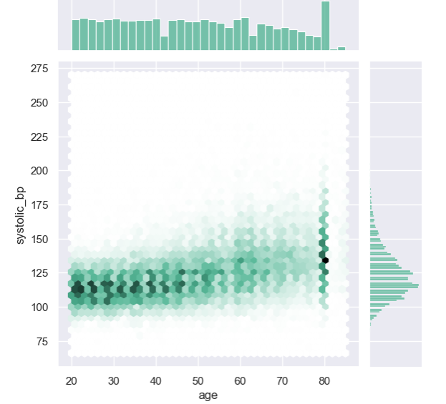
Correlations
Pairplots
Correlation Matrix
Hexabin plot
Notes:
We also explored how different columns relate to each other while certain columns like Waist Size and BMI showed a strong positive correlation, one increasing with another.
Age and systolic blood pressure showed a weaker positive correlation, while most of participants had blood pressure around same age, we noticed an increase in range with age.

Slide 12
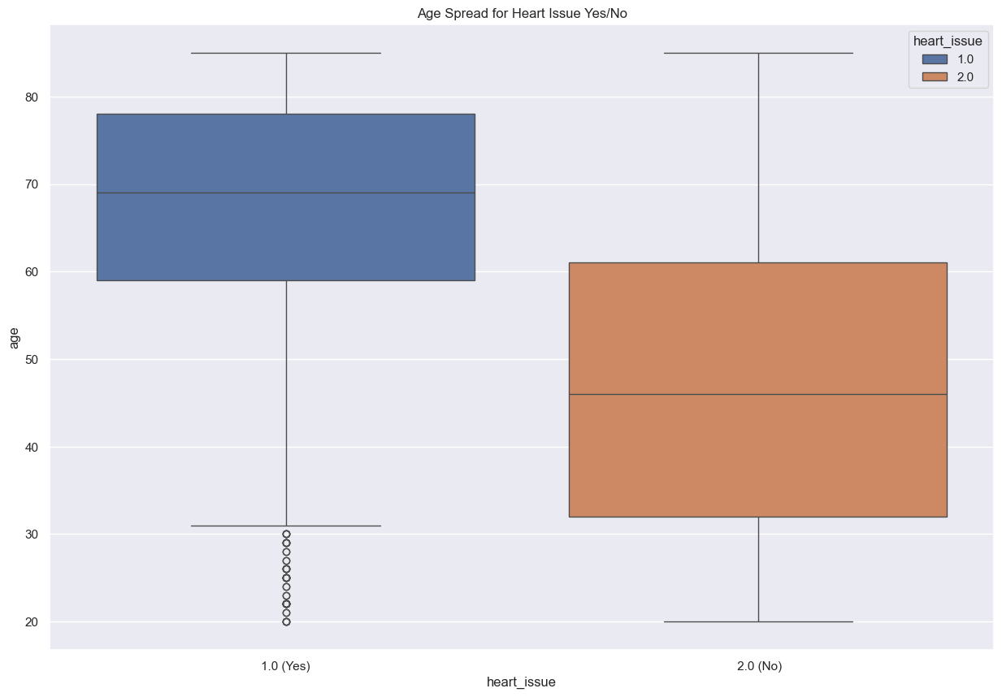
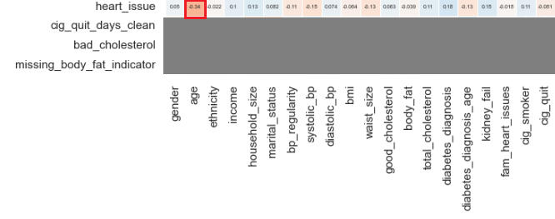
Exploring High Correlations
Age the biggest Factor
Notes:
Exploratory Data Analysis or EDA is probably my favorite stage.
In chess there is this idea of seeing big picture first and getting a feel, before we get caught up in the moves.
Similarly with any Data science problem EDA is the stage where we build an understanding of our dataset. Digging deep and exploring different relations not only allows us to gain valuable intuition but also enables us to do sanity checks for both incoming data and output.
In our case during EDA it became clear that age was biggest indicator of potential cardio event.
(Avg Age 50, mode around 80)

Slide 13

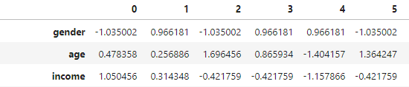
Preprocessing – Machine Ready
Train – Test Split (70 – 30%)
Missing Values
Encoding Values
Scaling (Standard)
Notes:
At this point we are wrapping up the exploration phase and getting ready to make some predictions!!
Now Machines only taking numbers, preferably small numbers.
So, we had to deal with missing values which we did by finding medians grouped by gender.
Also, since we had non-numerical values, for e.g. gender and income which came as income brackets, we converted them to numbers
With gender order doesn’t matter but with income brackets numbers represent the sequential nature of their original values, with lower income brackets getting smaller numbers and larger ones larger number.
At this point we converted these to a scale so that each column averages at 0, with a unit variance.
This ensures all columns get equal chance to impact prediction otherwise columns with bigger numbers can have more of a say.

Slide 14
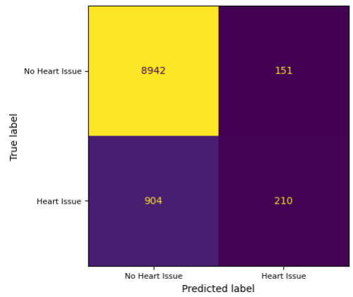
Modeling
4 Classifiers
Myth of Accuracy
Base Logistic - Accuracy 90%
Recall 0.19

Slide 15
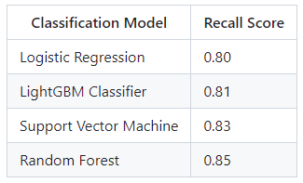
Model Evaluation
Training Data
GridSearch CV
Hyperparameters

Slide 16
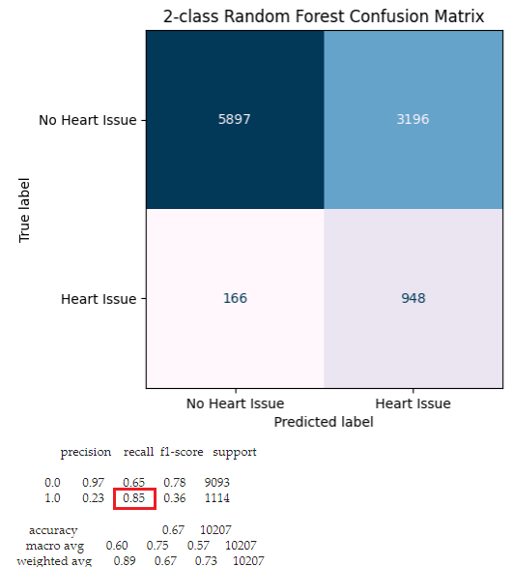
Random Forest
Best Hyperparameters:
n_estimators = 25
max_depth = 3
max_features = default (sqrt)

Slide 17
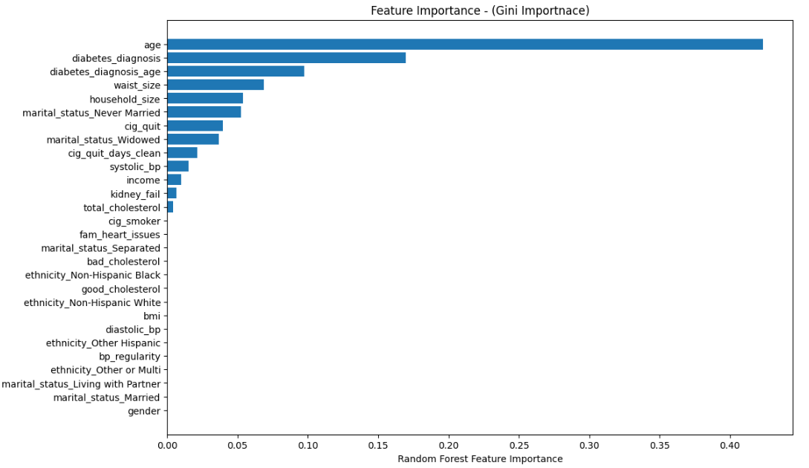
Important Indicators
Age
Diabetes
Waist Size
Days since last smoke

Slide 18
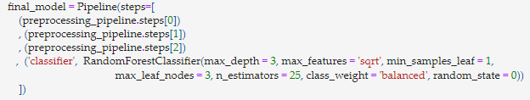


Summary
Cleaned raw CDC data
Selected a classifier
Built a pipeline

Slide 19
Future Scope
Dimensionality Reduction
Exploring new features
User Interface

Slide 20

Thank You
Notes:
Thank you! For your patience and time, Please let me know if I can address any specific questions or provide further information. Thank you!

